Slide 1


Data Analytics

Slide 2


Today’s Agenda
Project Recap
To provide a high level overview of the business problem we are tackling and the precise requirements, we will provide a summary of the entire project.
Problem
We will get into the particular issue that the data analytics team has been concentrating on and provide some context for why this is such a concern.
The analytics team
I’ll start by outlining the issue and then discuss the team that is in charge of handling this assignment on our end
Process
After that I’ll go into the general steps we took to do this assignment so you can better understand how we approach tasks of this nature.
Insights & Summary
Finally, I will review all significant findings and offer them as a collection of understandings and illustrations from our findings.

Slide 3

“Social Buzz” is a rapidly expanding unicorn in the
technology space that needs to quickly adjust to its
global reach.
Accenture has started working on the following
activities during a three-month POC:
1) An examination of Social Buzz’s view of Big Data
2) Strategies for a prosperous initial public offering.
3) An examination to determine the top 5 content
categories on social buzz.
Project Recap

Slide 4

Problem
In recent years, customers have grown to an enormous extent, and they lack the necessary internal resources to manage it.
Everyday, Social Buzz receives over 100,000 posts, totalling 36,500,000 posts annually. Since, all the content is unstructured, it might be challenging to make sense of it all.
Determine the specifications that must be needed to fulfil this project.
Combining samples from the sample data set.
An analysis of their content categories that identifies the top five with the highest total popularity.

Slide 5



Fatima Fazil
Sr. Data Analyst
The Analytics team
Camilla Martinez
Data Analyst
Gibran Khalil
Jr. Data Analyst

Slide 6
Understanding Data
Process
1
Data Cleaning
2
Data Analysis
3
4
Data Modelling
5
Uncover Insights

Slide 7

Insights
Category With Highest Score
Animals
Unique Categories
Month With Most Posts
16
75K
MAY

Slide 8
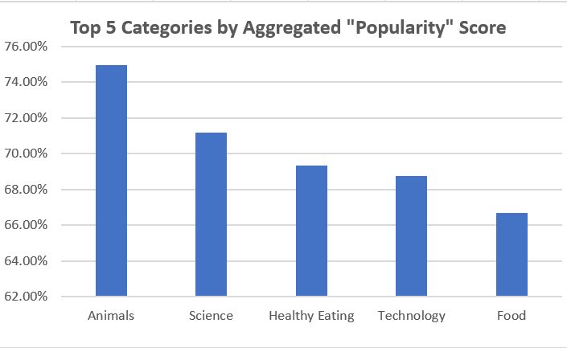

Slide 9
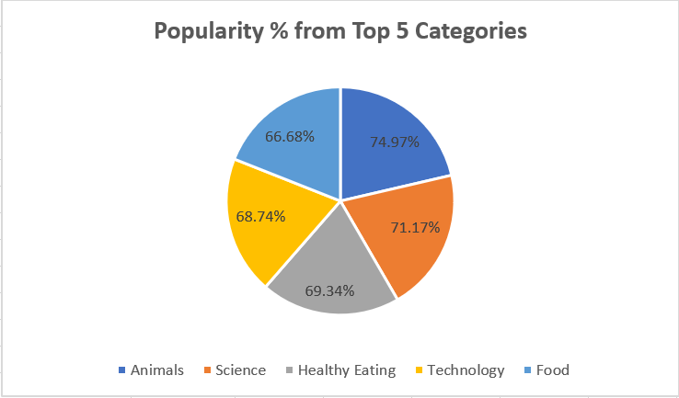

Slide 10

Analysis
Animals and Science are two of the most popular content categories, this shows that people enjoy “real-life” and “factual” content the most. So, I would recommend that you keep creating more content relating to these two categories.
Insights
Food is a common theme with the top 5 categories with “Healthy Eating” ranked as one of the highest. This may give an indication to the audience within your user base. You could use the insight to create a campaign & work with Healthy eating brands to boost user engagement.
Summary
Next Steps
It should come as no surprise that technological content is among the top categories given the advancement of technology. It indicates that users like your technological materials. Working with some of the biggest digital companies in the world is something I would suggest doing because it would undoubtedly increase user engagement.

Slide 11
Thank you!
ANY QUESTIONS?

